Slide 1
Applied Natural Language Processing
Dr. Sucharitha Shetty

Slide 2
Table of Contents
Recall of Last Class
Out-of-Vocabulary
Types of Tokenization
TFIDF
One Hot Encoding
Cosine Similarity

Slide 3
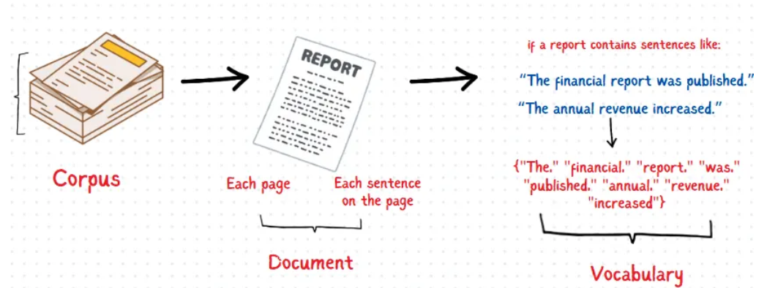
Terminologies
Imagine you’re analyzing monthly financial reports for your company.

Slide 4
Out-of-Vocabulary Words
In a closed vocabulary language model, there are no unknown words or out-of-vocabulary words (OOV).
In an open vocabulary system, you will find new words that are not present in the trained model.
Pick words below a certain frequency and label them as OOV.
Treat every OOV as a regular word.
During testing, the new words would be treated as OOV and the corresponding frequency will be used for computation.
This eliminates zero probability for sentences containing OOV.

Slide 5
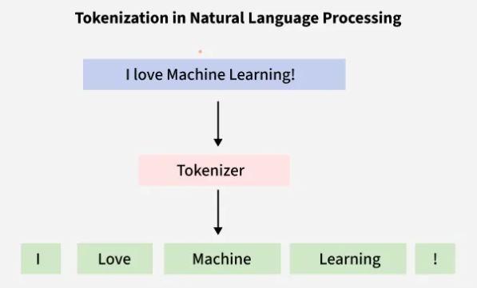
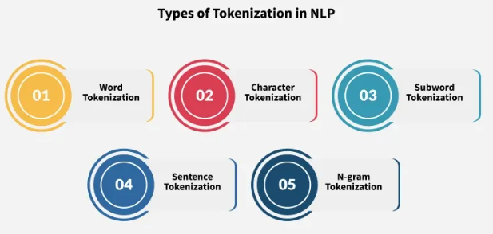
Types of Tokenization
Tokenization is a foundation step in NLP pipeline that shapes the entire workflow.
Involves dividing a string or text into a list of smaller units known as tokens.
Uses a tokenizer to segment unstructured data and natural language text into distinct chunks of information, treating them as different elements.
Notes:
4

Slide 6
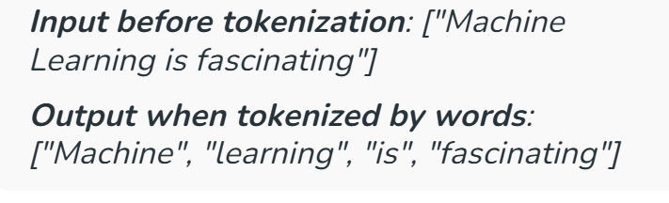
Word Tokenization
Word tokenization is the most commonly used method where text is divided into individual words. It works well for languages with clear word boundaries, like English. For example, "Machine learning is fascinating" becomes:
Notes:
4

Slide 7
Word Tokenization
Advantages:
Simple and easy to apply to languages like English, where words are separated by
spaces.
Effective for basic NLP tasks like keyword search and text classification.
Disadvantages:
Not suitable for languages without spaces between words, such as Chinese, Japanese, and Korean.
Difficult to handle compound words.
Applications:
Keyword search systems, Machine translation and chatbots, Sentiment analysis.
Notes:
6

Slide 8
Word Tokenization
Examples:
Closed compound words (no space)
notebook, toothpaste, football
  Should they be one token or split into note + book?
Hyphenated compounds
well-known, state-of-the-art
  Tokenizer may split incorrectly at hyphens.
Open compounds
ice cream, post office
  Tokenizer may treat them as separate words though they represent one concept.
Domain-specific compounds
creditcardnumber, machinelearning
  Common in technical or informal text and difficult to tokenize properly.
Notes:
7

Slide 9
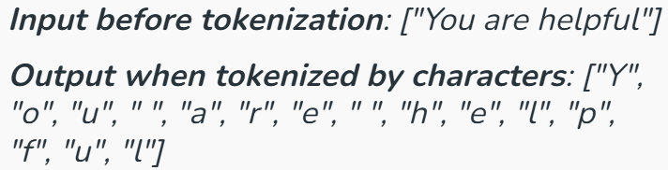
Character Tokenization
In Character Tokenization, the textual data is split and converted to a sequence of individual characters. This approach is useful for processing languages with complex structures, ambiguous spelling systems, or applications such as handwriting recognition and OCR (Optical Character Recognition).
Notes:
8

Slide 10
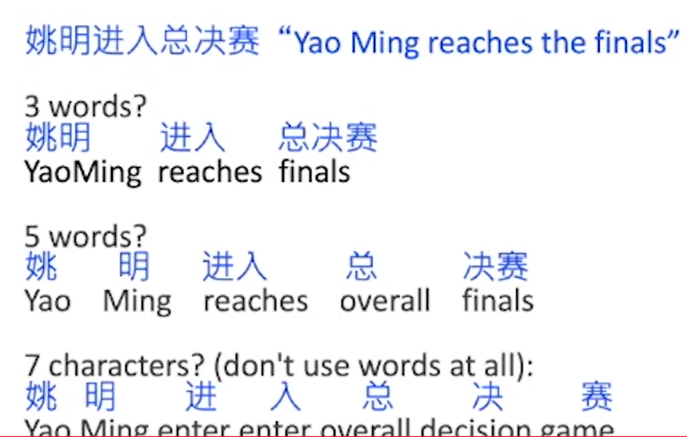
How to do word tokenization in Chinese
Notes:
8

Slide 11
Character Tokenization
Advantages:
Effective for languages without spaces (e.g., Chinese, Japanese, Korean).
Helps recognize new words or misspellings.
Handles Out-of-Vocabulary (OOV) words well.
Disadvantages:
Generates too many tokens, increasing NLP model complexity.
Loses word-level meaning, making it harder to maintain context.
Applications:
Processing Chinese, Japanese, and Korean text.
Detecting misspelled words.
Notes:
5

Slide 12
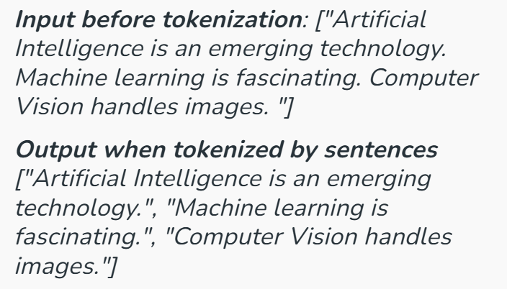
Sentence Tokenization
Sentence tokenization is also a common technique used to make a division of paragraphs or large set of sentences into separated sentences as tokens. This is useful for tasks requiring individual sentence analysis or processing.
Notes:
7

Slide 13
Sentence Tokenization
Advantages:
Maintains the semantic structure of sentences, improving text analysis accuracy.
Essential for text summarization and machine translation.
Disadvantages:
Struggles with abbreviations and special punctuation cases.
Can be inaccurate when sentences lack clear punctuation.
Applications:
Automatic text summarization.
Question-answering systems like Google Assistant and ChatGPT.
Text analysis and machine translation
Notes:
11

Slide 14
Sentence Tokenization
Examples:
Abbreviations
Dr. Smith is a professor.
he tokenizer may wrongly split after Dr.
This happened in the U.S.A.
last year.The tokenizer may treat U.S.A. as multiple sentence endings.
Special punctuation
He scored 95.5 marks.
The period in 95.5 is not a sentence boundary.
Wait... what happened?
Multiple dots (ellipsis) can confuse sentence boundaries.
Notes:
12

Slide 15
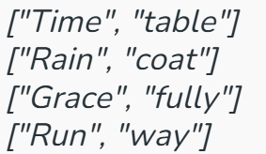
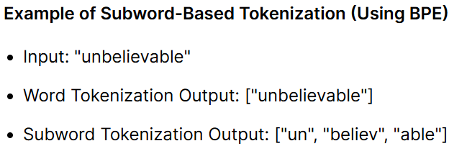
Sub-word Tokenization
This strikes a balance between word and character tokenization by breaking down text into units that are larger than a single character but smaller than a full word. This is useful when dealing with morphologically rich languages or rare words.
Sub-word tokenization helps to handle out-of-vocabulary words in NLP tasks and for languages that form words by combining smaller units.
Notes:
6

Slide 16
Sub-word Tokenization
Advantages:
Helps NLP models understand complex words.
Effective in machine translation and speech recognition.
Suitable for multiple languages, including Vietnamese.
Disadvantages:
Requires more complex algorithms to generate subword tokens.
Depends on training data; errors may occur if a model has never seen a particular subword before.
Common Methods:
Byte Pair Encoding (BPE): Used in GPT-3, GPT-4, and T5.
WordPiece: Used in BERT and ALBERT.
Unigram Language Model: Used in SentencePiece.
Notes:
12

Slide 17
Byte-Pair Encoding for Tokenization
Step 1: The BPE token learner begins with a vocabulary that is just the set of all
individual characters.
Step 2 : It then examines the training corpus, chooses the two symbols that are most
frequently adjacent (say ‘A’, ‘B’), adds a new merged symbol ‘AB’ to the
vocabulary, and replaces every adjacent ’A’ ’B’ in the corpus with the new ‘AB’
Step 3: It continues to count and merge, creating new longer and longer character
strings, until k merges have been done creating k novel tokens; k is thus a parameter of the algorithm.
The resulting vocabulary consists of the original set of characters plus k new symbols.
Notes:
10

Slide 18
Byte-Pair Encoding for Tokenization
https://medium.com/@akshayhitendrashah/natural-language-processing-ea5de219c4c2
Notes:
8

Slide 19
Byte-Pair Encoding for Tokenization
Assume a tiny corpus:
Text:low lower lowest
Final BPE tokenization result
Now tokenize the original words using learned subwords:
Word | BPE Tokens
low | low
lower | low + er
lowest | low + est
Notes:
18

Slide 20
Byte-Pair Encoding for Tokenization
Assume a tiny corpus:
Text: low lower lowest
Final BPE tokenization result
Now tokenize the original words using learned subwords:
Word | BPE Tokens
low | low
lower | low + er
lowest | low + est
Notes:
19

Slide 21
Byte-Pair Encoding for Tokenization
How these tokens are used in NLP (final result)
Each token gets an ID
low → 101
er → 102
est → 103
2. Text is converted to token IDs
lower → [101, 102]
lowest → [101, 103]
Notes:
20

Slide 22
Byte-Pair Encoding for Tokenization
3. IDs → embeddings
Each token ID is mapped to a vector.
These vectors are input to NLP models (LSTM, Transformer, BERT, etc.).
4. Model learns meaning
low captures common meaning
er, est capture degree (comparative, superlative)
Helps handle unknown words and morphology
Notes:
21

Slide 23
Byte-Pair Encoding for Tokenization
Modern tokenizers often automatically induce sets of tokens that include tokens smaller than words, called subwords.
Subwords can be arbitrary substrings, or they can be meaning-bearing units like the morphemes -est or -er. (Morphemes)
In modern tokenization schemes, most tokens are words, but some tokens are frequently occurring morphemes or other subwords like -er.
Every unseen words like lower can thus be represented by some sequence of known subword units, such as low and er
Notes:
9

Slide 24

Byte-Pair Encoding for Tokenization
Example: Input corpus of 18 word tokens with counts for each word (the word low appears 5 times, the word newer 6 times, and so on), which would have a starting vocabulary of 11 letters
The most frequent is the pair e r because it occurs in newer (frequency of 6) and wider (frequency of 3) for a total of 9 occurrences.
Notes:
11

Slide 25


Byte-Pair Encoding for Tokenization
Treating er as one symbol, and counted again:
Now the most frequent pair is er_ , which we merge; system has learned that there should be a token for word-final er, represented as er_ :
Notes:
12

Slide 26


Byte-Pair Encoding for Tokenization
Next n e (total count of 8) get merged to ne:
If continued, the next merges are:
Notes:
13

Slide 27
Byte-Pair Encoding for Tokenization
Once vocabulary is learned, the token parser is used to tokenize a test sentence. The token parser just runs on the test data the merges that has been have learned from the training data, greedily,
Notes:
14

Slide 28
Byte-Pair Encoding for Tokenization
First segment each test sentence or word into characters.
Then apply the first rule: replace every instance of e r in the test corpus with er
The apply the second rule: replace every instance of er in the test corpus with er_ , and so on.
By the end, if the test corpus contained the word n e w e r_ , it would be tokenized as a full word.
In real algorithms BPE is run with many thousands of merges on a very large input corpus.
After training :
On the test data run each merge learned on training data.
Test set “n e w e r _” will be tokenized as a full word
Test set “l o w e r _” will be tokenized as “low er_”
Notes:
15

Slide 29
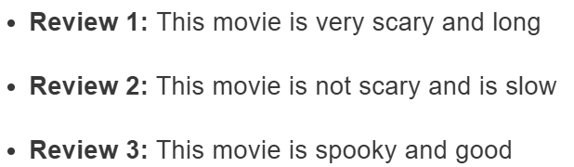
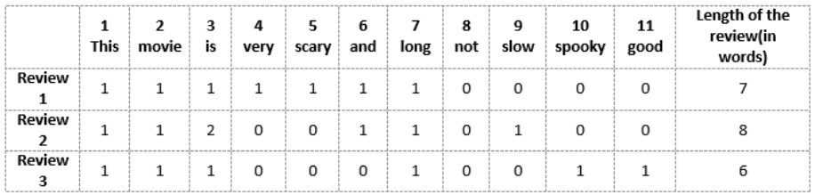
Vector-of-Review1: [1 1 1 1 1 1 1 0 0 0 0]
Vector-of-Review2: [1 1 2 0 0 1 1 0 1 0 0]
Vector-of-Review3: [1 1 1 0 0 0 1 0 0 1 1]
Bag of Words
We can now take each of these words and mark their occurrence in the three movie reviews above with 1s and 0s. This will give us 3 vectors for 3 reviews:
Vector-of-Review1: [1 1 1 1 1 1 1 0 0 0 0]
Vector-of-Review2: [1 1 2 0 0 1 1 0 1 0 0]
Vector-of-Review3: [1 1 1 0 0 0 1 0 0 1 1]

Slide 30
Drawbacks of using a Bag-of-Words (BoW) Model
If the new sentences contain new words, then our vocabulary size would increase and thereby, the length of the vectors would increase too.
Additionally, the vectors would also contain many 0s, thereby resulting in a sparse matrix (which is what we would like to avoid)
We are retaining no information on the grammar of the sentences nor on the ordering of the words in the text.

Slide 31
TF-IDF
Term frequency–inverse document frequency, is a numerical statistic that is intended to reflect how important a word is to a document in a collection or corpus.

Slide 32

Term Frequency (TF)
Let’s first understand Term Frequent (TF). It is a measure of how frequently a term, t, appears in a document, d:
Here, in the numerator, n is the number of times the term “t” appears in the document “d”. Thus, each document and term would have its own TF value.

Slide 33
Term Frequency (TF)
Review 2: This movie is not scary and is slow
Vocabulary: ‘This’, ‘movie’, ‘is’, ‘very’, ‘scary’, ‘and’, ‘long’, ‘not’, ‘slow’, ‘spooky’, ‘good’
Number of words in Review 2 = 8
TF for the word ‘this’ = (number of times ‘this’ appears in review 2)/(number of terms in review 2) = 1/8
Similarly,
TF(‘movie’) = 1/8 TF(‘is’) = 2/8 = ¼ TF(‘very’) = 0/8 = 0 TF(‘scary’) = 1/8
TF(‘and’) = 1/8 TF(‘long’) = 0/8 = 0 TF(‘not’) = 1/8 TF(‘slow’) = 1/8
TF( ‘spooky’) = 0/8 = 0 TF(‘good’) = 0/8 = 0

Slide 34
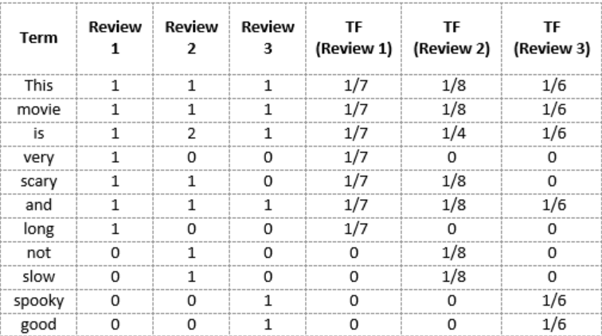
Term Frequency (TF)

Slide 35
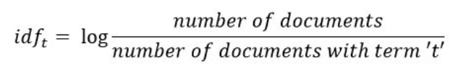
Inverse Document Frequency (IDF)
IDF is a measure of how important a term is. We need the IDF value because computing just the TF alone is not sufficient to understand the importance of words:

Slide 36
IDF
Review 2: This movie is not scary and is slow
IDF(‘this’) = log(number of documents/number of documents containing the word ‘this’) = log(3/3) = log(1) = 0
Similarly,
IDF(‘movie’, ) = log(3/3) = 0 IDF(‘is’) = log(3/3) = 0
IDF(‘not’) = log(3/1) = log(3) = 0.48 IDF(‘scary’) = log(3/2) = 0.18
IDF(‘and’) = log(3/3) = 0 IDF(‘slow’) = log(3/1) = 0.48

Slide 37
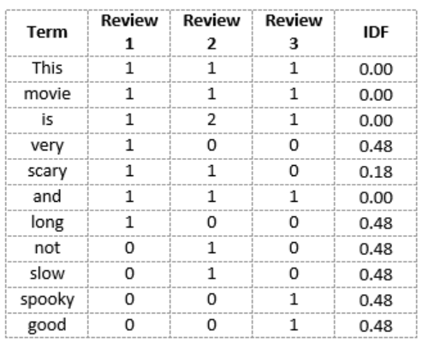
IDF
We see that words like “is”, “this”, “and”, etc., are reduced to 0 and have little importance; while words like “scary”, “long”, “good”, etc. are words with more importance and thus have a higher value.

Slide 38

TF-IDF Score
Words with a higher score are more important, and those with a lower score are less important:
We can now calculate the TF-IDF score for every word in Review 2:
TF-IDF(‘this’, Review 2) = TF(‘this’, Review 2) * IDF(‘this’) = 1/8 * 0 = 0
Similarly,
TF-IDF(‘movie’, Review 2) = 1/8 * 0 = 0 TF-IDF(‘is’, Review 2) = 1/4 * 0 = 0
TF-IDF(‘not’, Review 2) = 1/8 * 0.48 = 0.06 TF-IDF(‘scary’, Review 2) = 1/8 * 0.18 = 0.023
TF-IDF(‘and’, Review 2) = 1/8 * 0 = 0 TF-IDF(‘slow’, Review 2) = 1/8 * 0.48 = 0.06

Slide 39
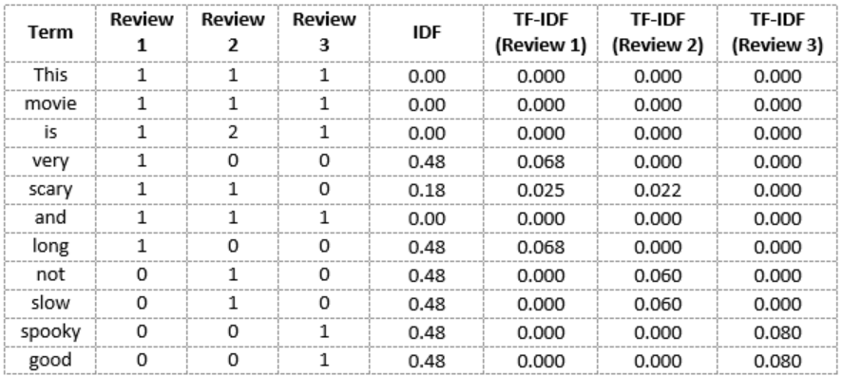
TF-IDF Score

Slide 40
TF-IDF Score
While both Bag-of-Words and TF-IDF have been popular in their own regard, there still remained a void where understanding the context of words was concerned. Detecting the similarity between the words ‘spooky’ and ‘scary’, or translating our given documents into another language, requires a lot more information on the documents.

Slide 41
TF-IDF Score
While both Bag-of-Words and TF-IDF have been popular in their own regard, there still remained a void where understanding the context of words was concerned. Detecting the similarity between the words ‘spooky’ and ‘scary’, or translating our given documents into another language, requires a lot more information on the documents.

Slide 42
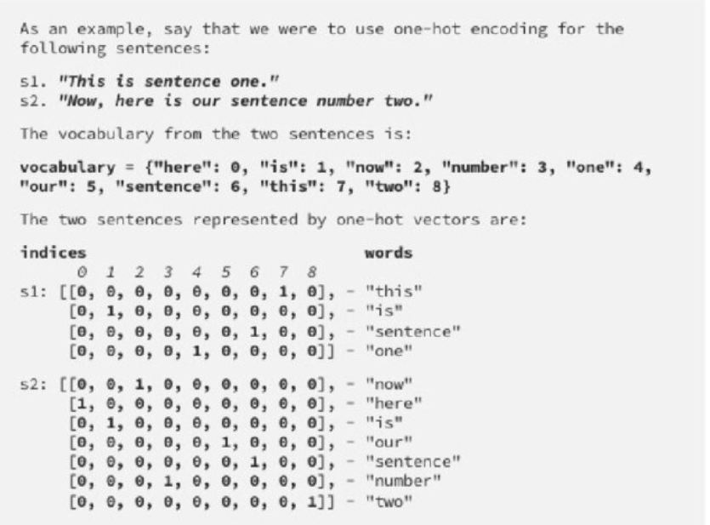
One-Hot
Encoding

Slide 43
A similarity measure is a function that computes the degree of similarity between two vectors.
A good distance metric helps in improving the performance of Classification, Clustering, and Information Retrieval process significantly.
Euclidean Distance
Manhattan Distance
Cosine Similarity
Similarity Measure

Slide 44



Named after the ancient Greek Mathematician Euclid
Euclidean Distance
While both Bag-of-Words and TF-IDF have been popular in their own regard, there still remained a void where understanding the context of words was concerned. Detecting the similarity between the words ‘spooky’ and ‘scary’, or translating our given documents into another language, requires a lot more information on the documents.
Notes:
18

Slide 45
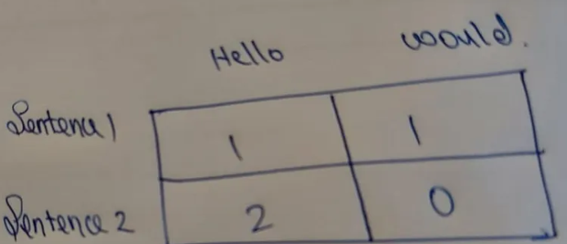
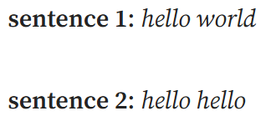
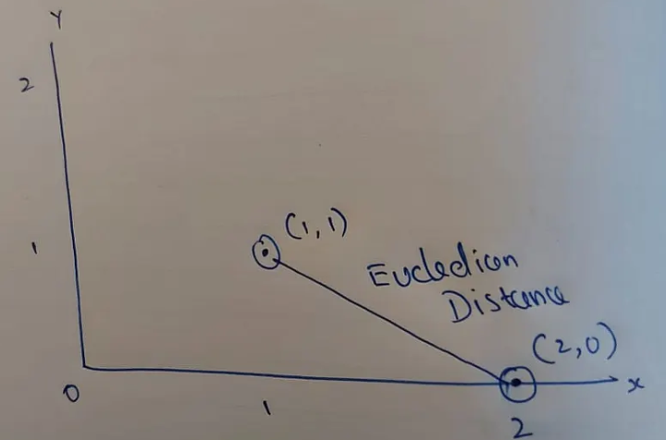
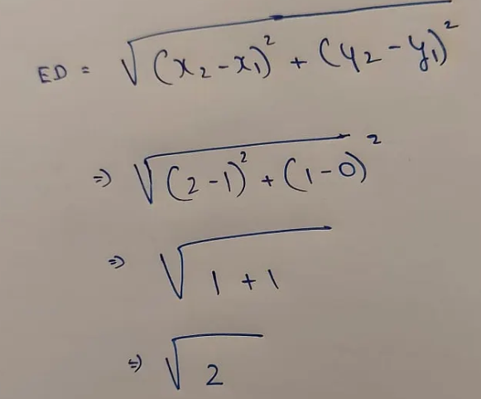
Euclidean Distance
ED is root of 2 is around 1.4142. Now if sentence 2 is hello hello hello
Notes:
19

Slide 46
Word embedding in natural language processing (NLP) refers to the technique of representing words as dense vectors of real numbers in a high-dimensional space.
This method captures semantic and syntactic similarities between words, allowing NLP models to understand the context and meaning of words within a given text.
Word embeddings are typically learned from large corpora of text using unsupervised learning techniques like neural networks, where words with similar meanings are mapped to nearby points in the embedding space.
Popular word embedding techniques include Bow,TF-IDF, Word2Vec, GloVe.
Word Embedding
Notes:
18

Slide 47
Word embedding :
Count/Frequency (BoW, TFIDF, One Hot Encoding)
Deep Learning Trained model (Word2Vec(CBOW,SkipGrams), AvgWord2Vec)
Pre-requisite: ANN, Optimizers and Loss Function
Embedding Layer is used to convert word to vectors
Word Embedding

Slide 48
Coding Time

Slide 49
Thank You

